Slide 1
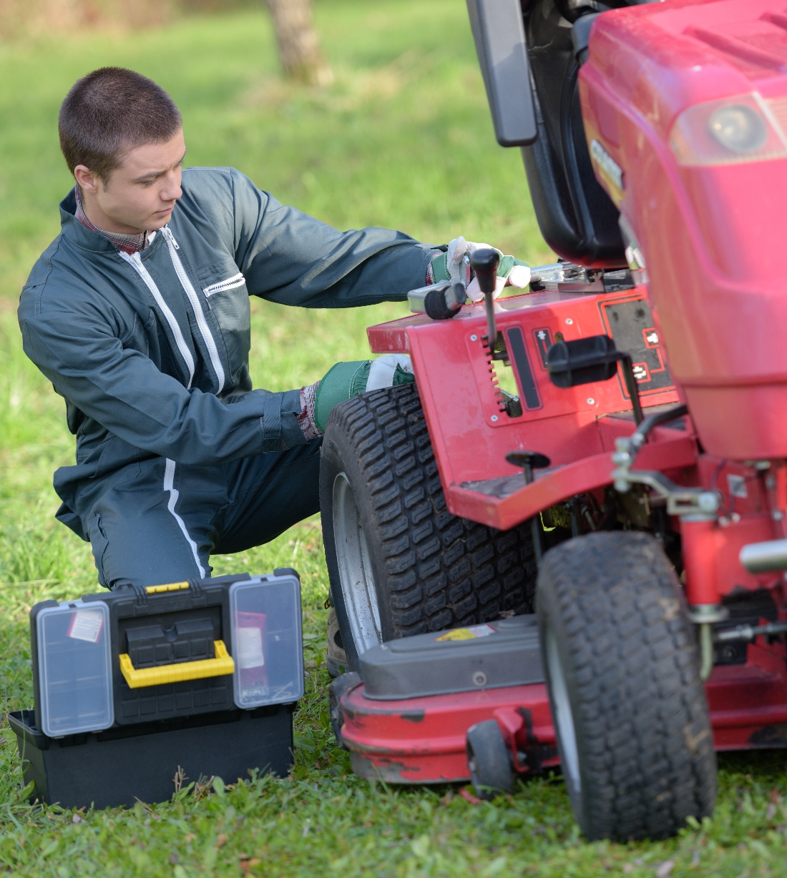
Service Excellence
Enhancing Efficiency In The
Service Department
February 2025
Jim Daum, Implementation Specialist

Slide 2
Agenda
1.
Time
2.
What is Efficiency?
3.
Labor Efficiency
4.
Your Service Process
5.
Finding Additional Information

Slide 3
Time = Money
Planning
Objective
Process
TIME
MANAGEMENT
Tools
Tasks
Control
Setting
priorities
Delegate
tasks

Slide 4
Improving Efficiency
EFFICIENCY
QUALITY
COST

Slide 5
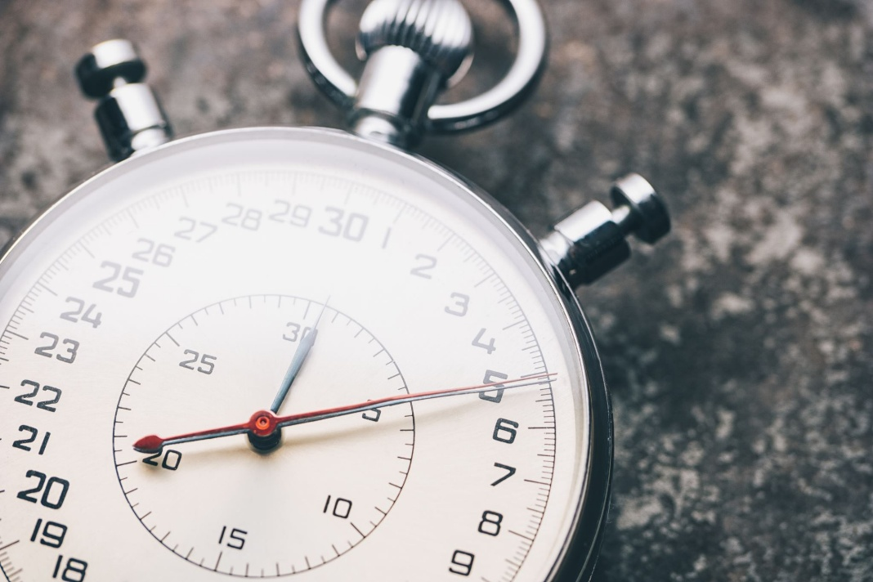
Efficiency Defined: Wrench Time vs Billable Time
VS

Slide 6
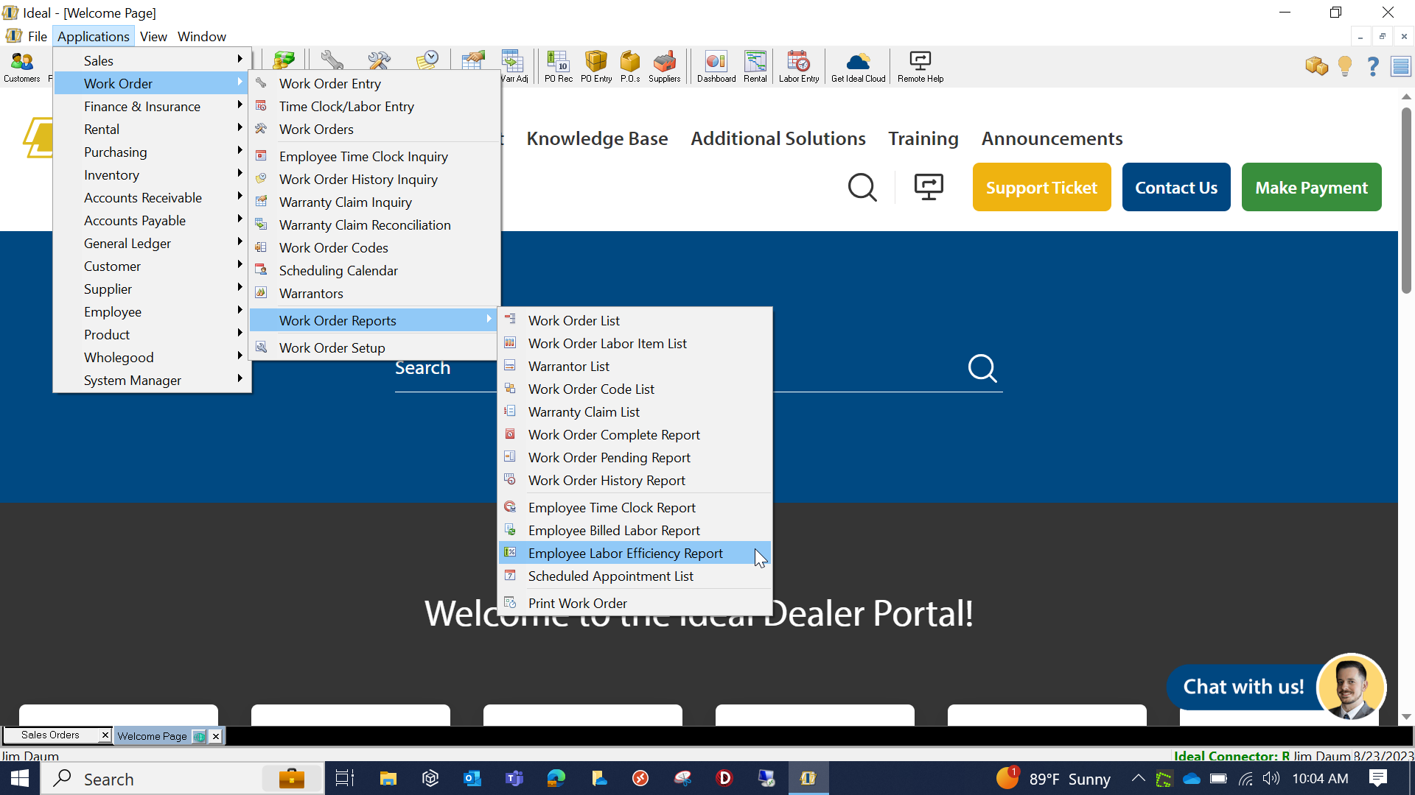
Labor Efficiency Report

Slide 7
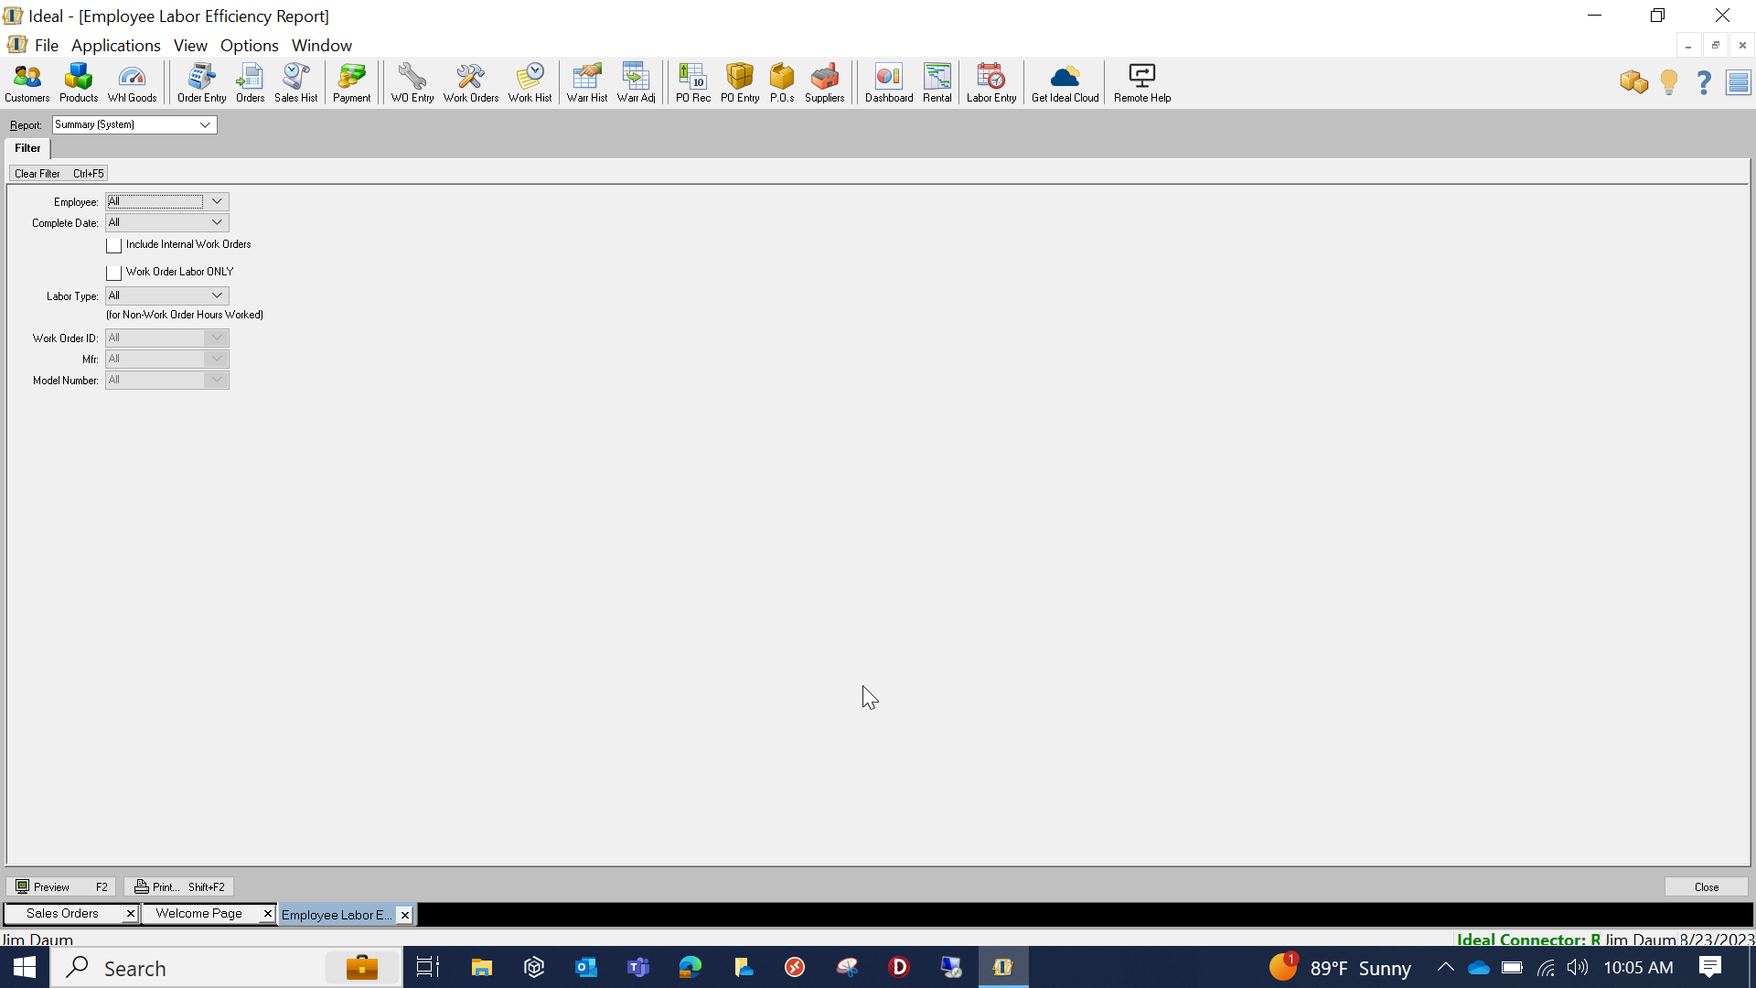
Labor Efficiency Filter

Slide 8
Knowledge Base Resources
Five Steps to Improve Efficiency
Running the Employee Labor Efficiency Report
Time Clock and Labor Time Clock Entry

