Slide 1
Why Work Order
Status Matters &
How to Change Them
February 2025
Jim Daum, Implementation Specialist

Slide 2
Agenda
1.
Your Service Process
2.
Work Order Statuses
3.
Determined by Your Service Process
4.
Process Will Reduce Turn Around Time
5.
Finding Additional Information

Slide 3
Process

Slide 4
Statuses
Match Your Process to Your Statuses

Slide 5
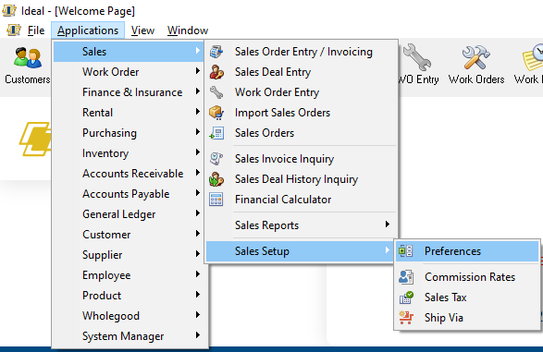
Statuses

Slide 6
Statuses

Slide 7
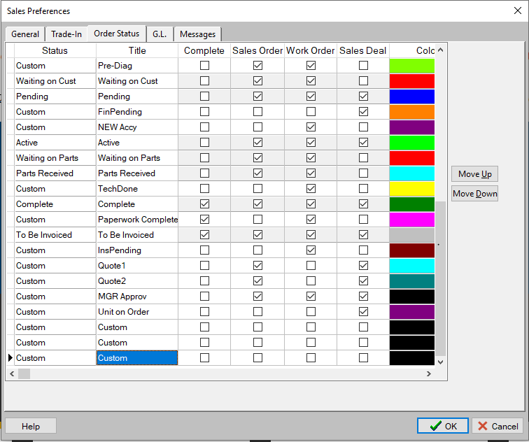
Statuses

Slide 8
Knowledge Base Resources
Changing the Titles and Color of Order Statuses
Checking The Status of Work Orders

