Slide 1
Electronic Interfaces
February 2025
Dave Baumgarten, Sr Implementation Specialist

Slide 2
Agenda
1.
Sending Purchase Orders to Manufacturers / Distributors Electronically
2.
Uploading Purchase Orders to Manufacturer / Distributor Website
3.
Submit Product Registration to Manufacturers (Ariens, Echo, Honda, Honda PS, Stihl)

Slide 3
Sending Purchase Orders to Manufacturers / Distributors Electronically

Slide 4
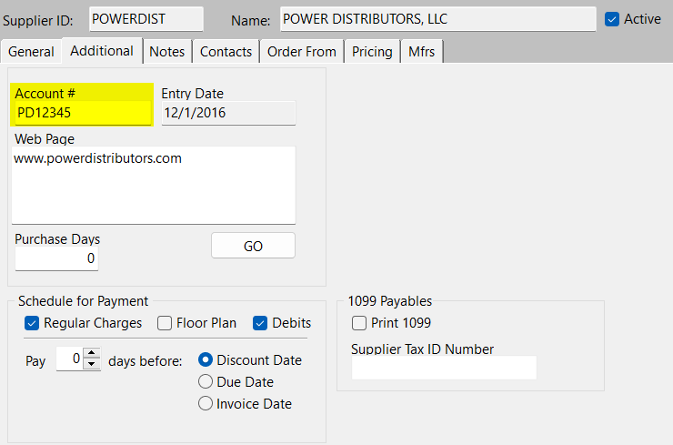
Supplier Properties – Additional Tab
Select the Additional tab in Supplier Properties
Enter the Dealer / Account #

Slide 5
Purchase Order Interfaces

Slide 6
Manufacturers / Distributors With Electronic Purchasing Options Available
ACE HADWARE | EXMARK | LAND N SEA | ROTARY
AES LAWN PARTS | FLORIDA OUTDOOR EQUIPMENT | MAHINDRA | STENS
A&I PRODUCTS | GARDNER INC | MEDART ENGINE | STIHL
ARCTIC CAT | GOLDEN EAGLE DISTRIBUTING | MEDART MARINE | SUZUKI
ARIENS | GRASS HOPPER | MERCURY MARINE | TORO
BOMBARDIER | HONDA | MIDWEST ENGINE WAREHOUSE | TRUE VALUE
CONNELL (GARDNER INC) | HOUSE-HASSON | ORGILL | TUCKER ROCKY
CENTRAL POWER DISTRIBUTORS | HUSQVARNA | OSCAR WILSON | WESCO
CLUB CAR | HUSTLER | PARTS UNLIMITED | WESTERN POWER SPORTS
CUB CADET | JOHN DEERE | POWER EQUIPMENT SYSTEMS | YAMAHA
DIXIE SALES (GARDNER INC) | KAWASAKI | POWER DISTRIBUTORD | YANMAR
DO IT BEST | KTM MOTOR | POLARIS
ENGINE WAREHOUSE | KPM DISTRIBUTORS | RBI CORPORATION

Slide 7
Uploading Purchase Orders to Manufacturer / Distributor Website

Slide 8
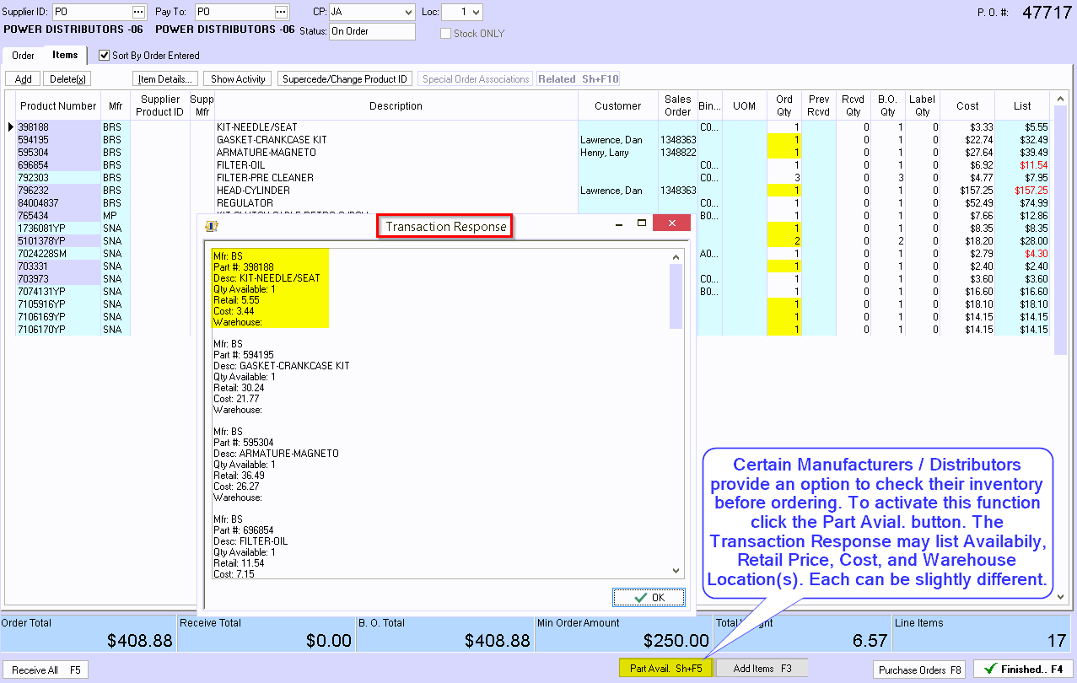

Slide 9
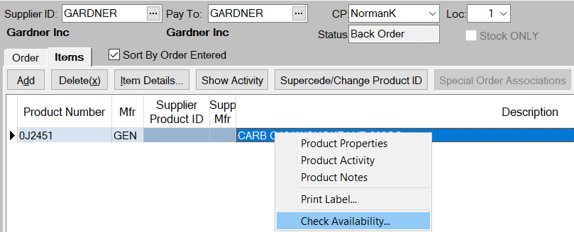
Part Numbers can be checked individually.
Right click and select Check Availability

Slide 10
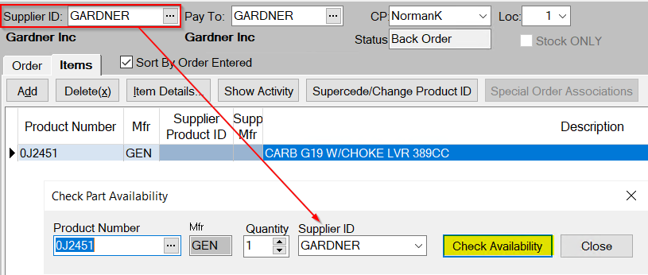
The Supplier is set to the same as the Order From ID select Check Availability

Slide 11
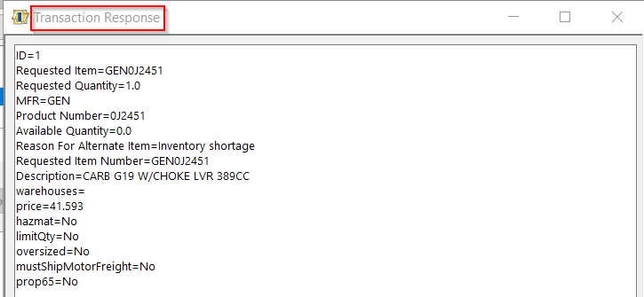
A response is received from the Supplier and displayed with important information

Slide 12
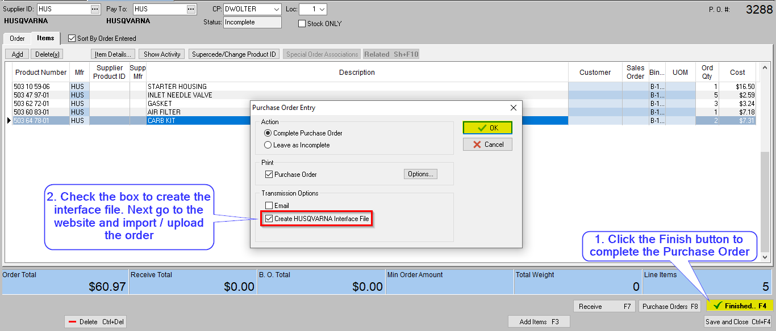
Some interfaces create a data file to be uploaded to the Manufacturer / Distributor website

Slide 13
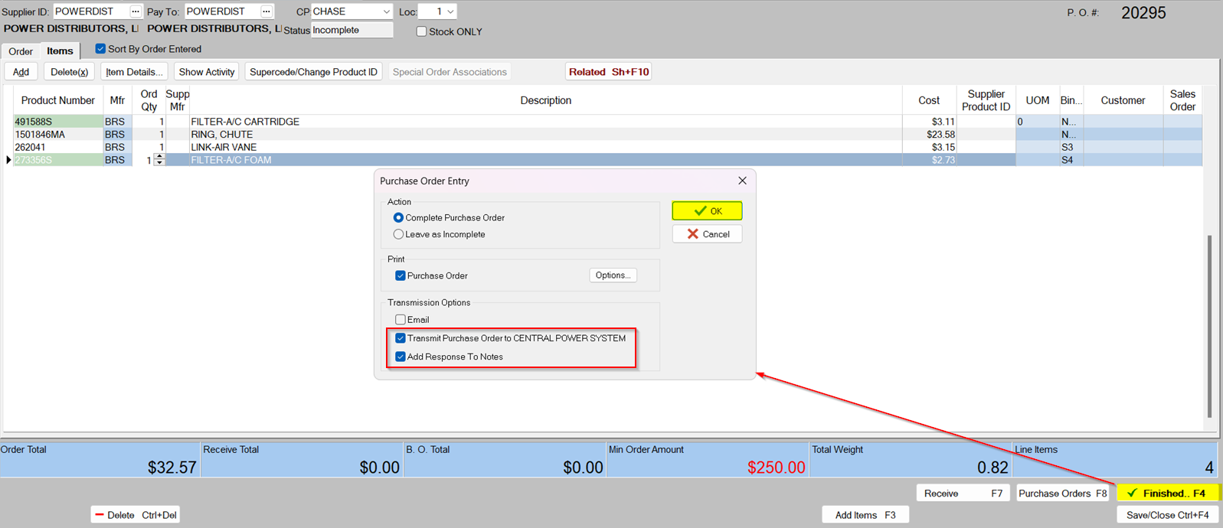

Slide 14
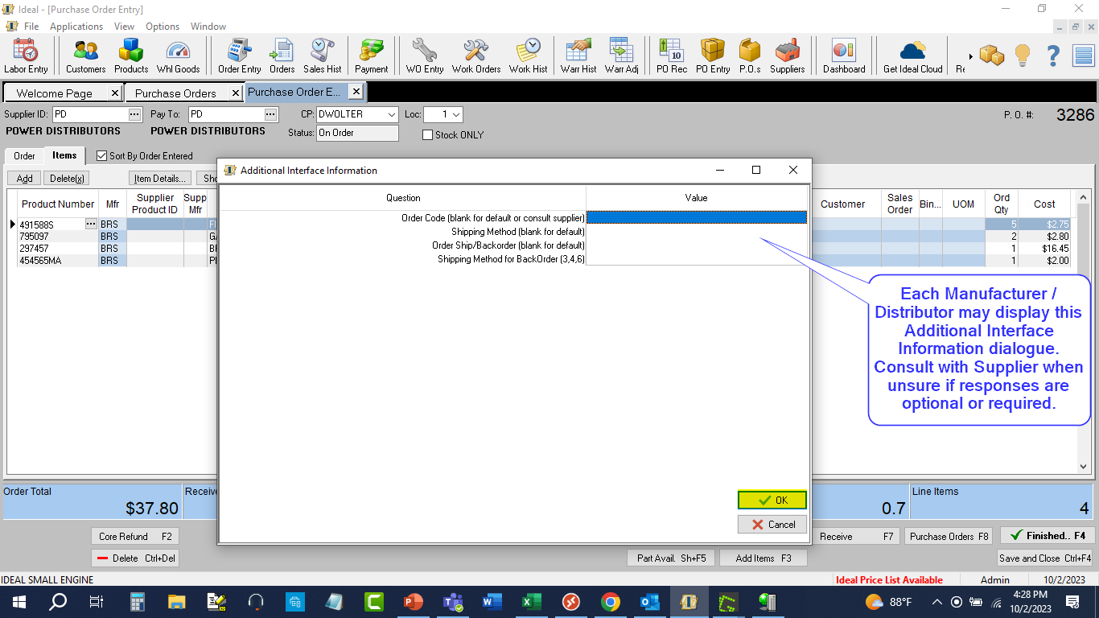

Slide 15
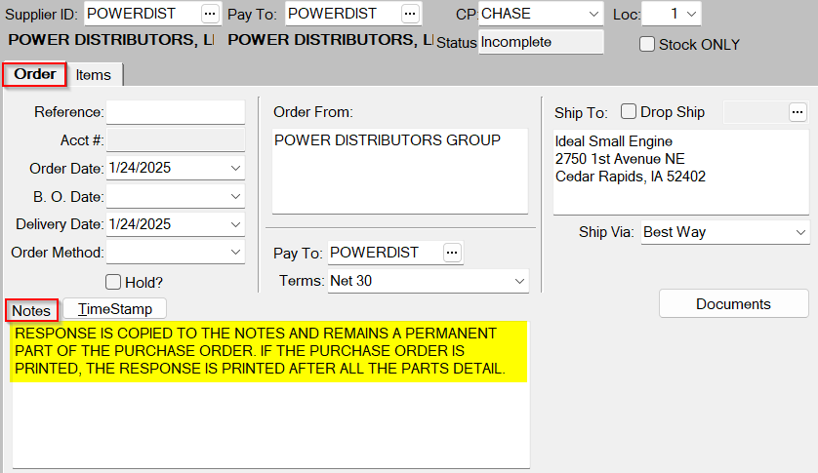
If Add Response to Notes is selected when transmitting the PO the response is placed in Notes

Slide 16
Sending Product Registrations to the Manufacturer

Slide 17
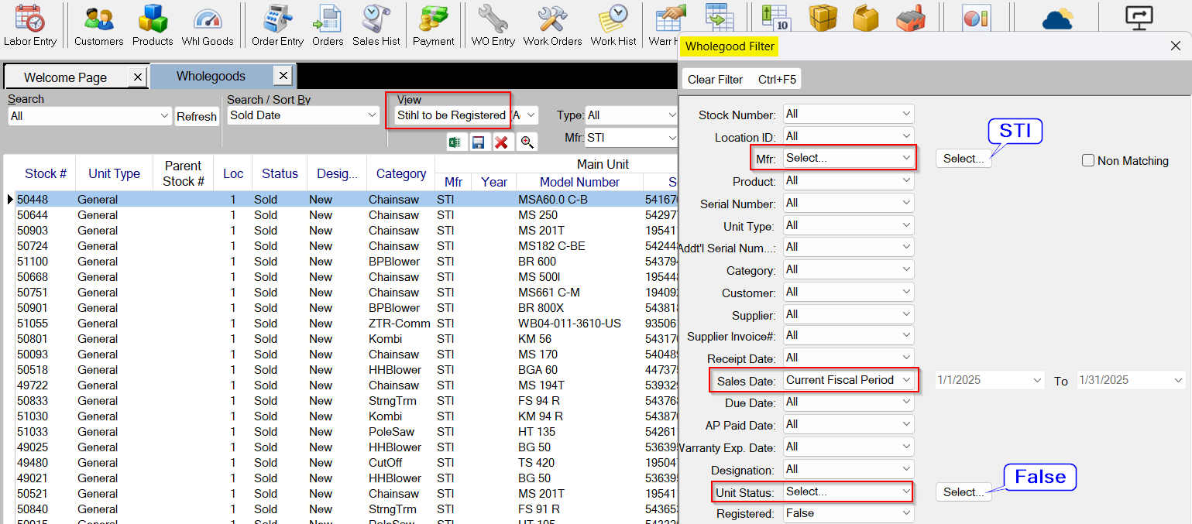
When wholegoods are sold, Registrations can be submitted to the Manufacturer

Slide 18
Highlight the unit to be registered then select properties

Slide 19
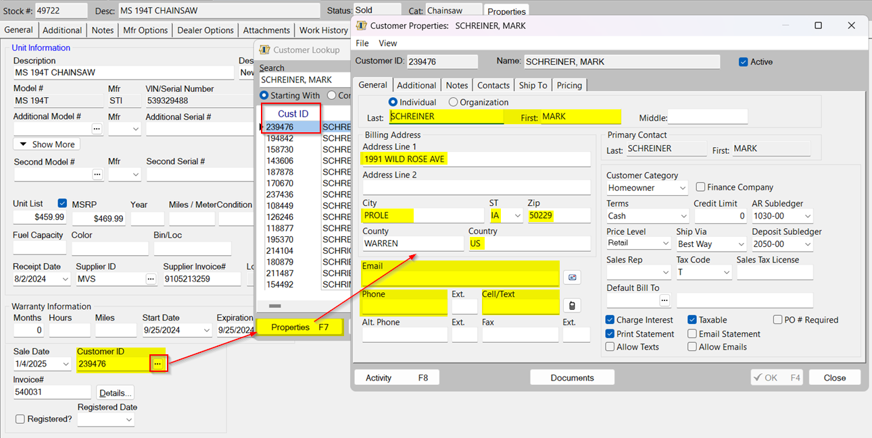
Before attempting to register, check the customer record for required information

Slide 20
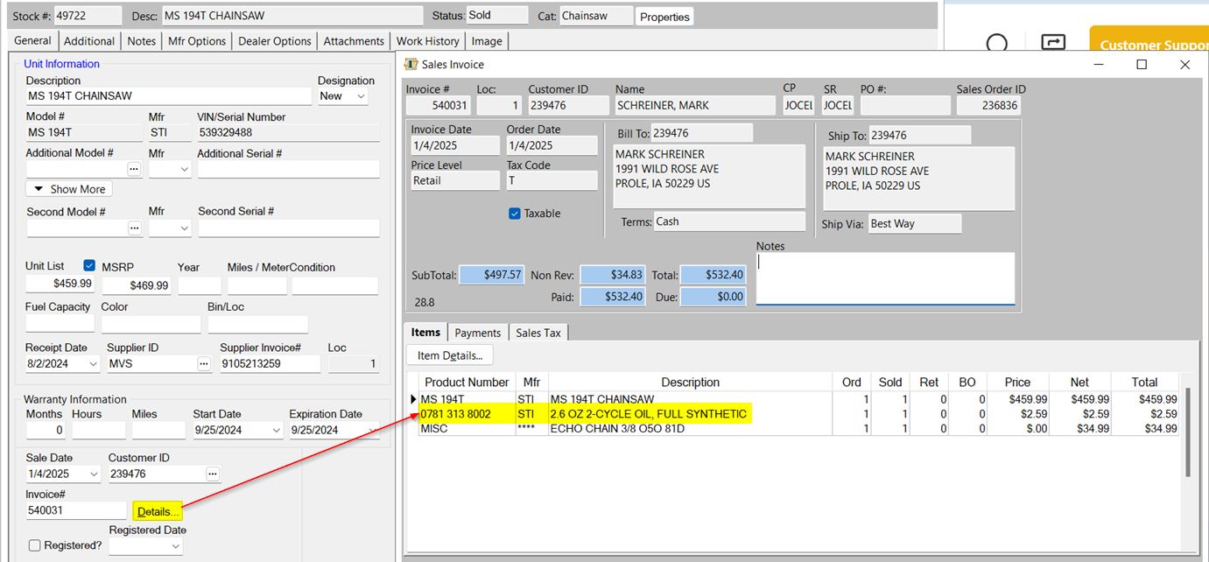
If necessary, view the Invoice for additional warranty related items purchased

Slide 21
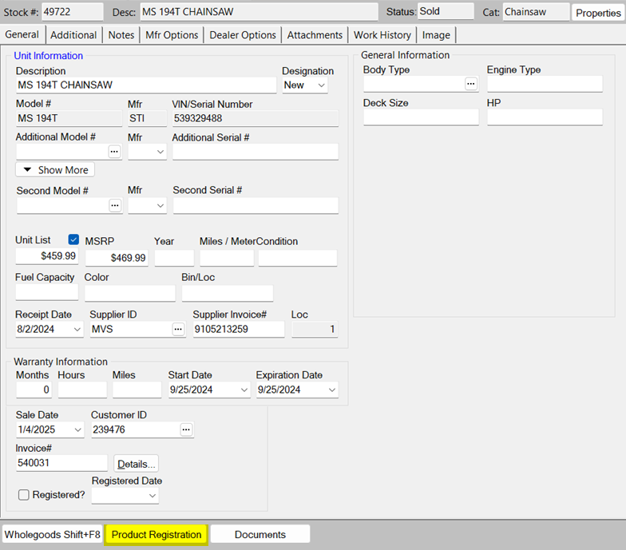
To Register the unit, select the Product Registration button

Slide 22
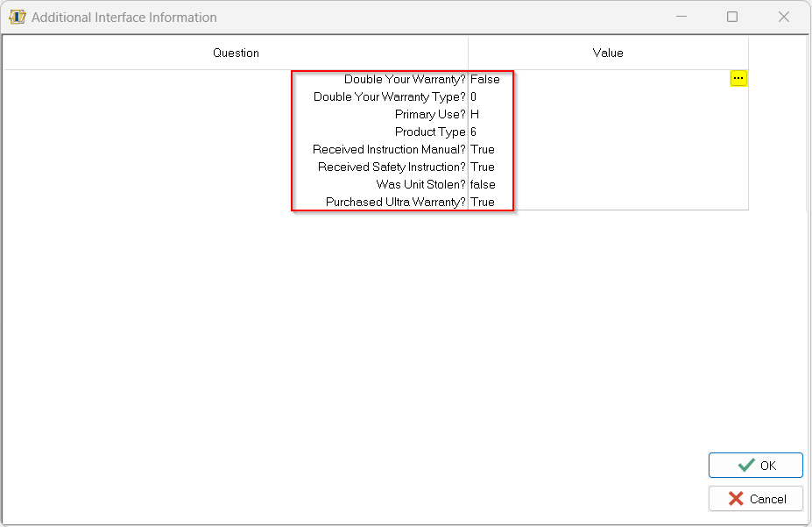
Click the ellipses for each question to select an appropriate response

Slide 23
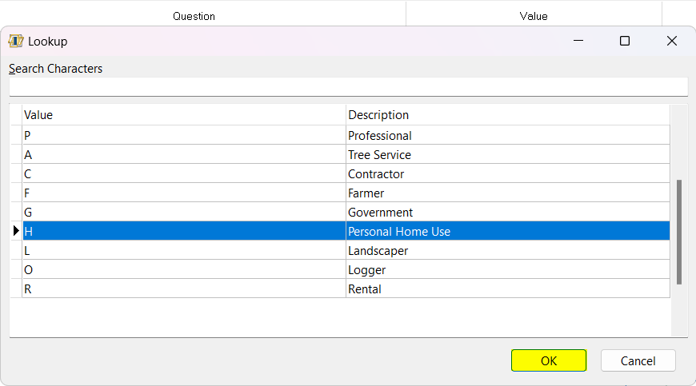
Each question may have different answers to select from depending on the brand and equipment type

Slide 24
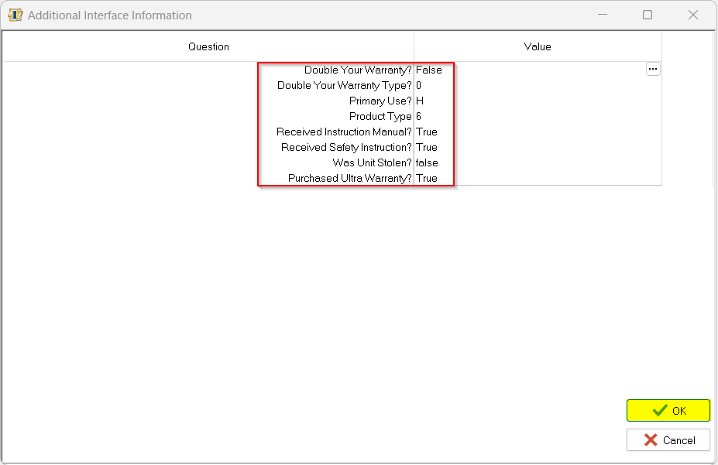
After selecting all required responses select the OK button to register the unit.
A response window will be returned indicating successful registration or noting errors to be corrected

Slide 25
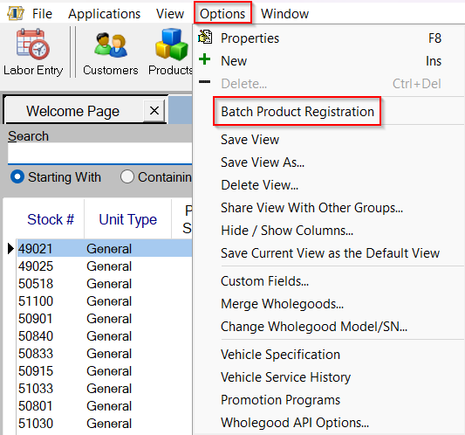
Registrations may be done in batches.

Slide 26
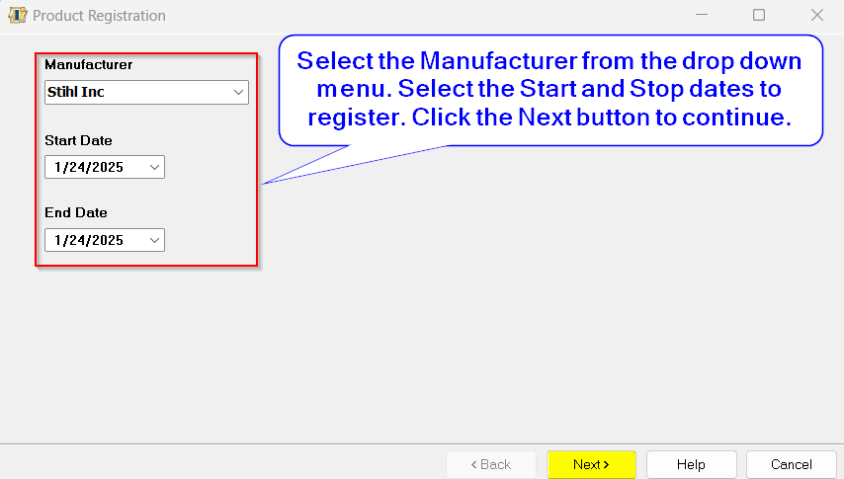

Slide 27
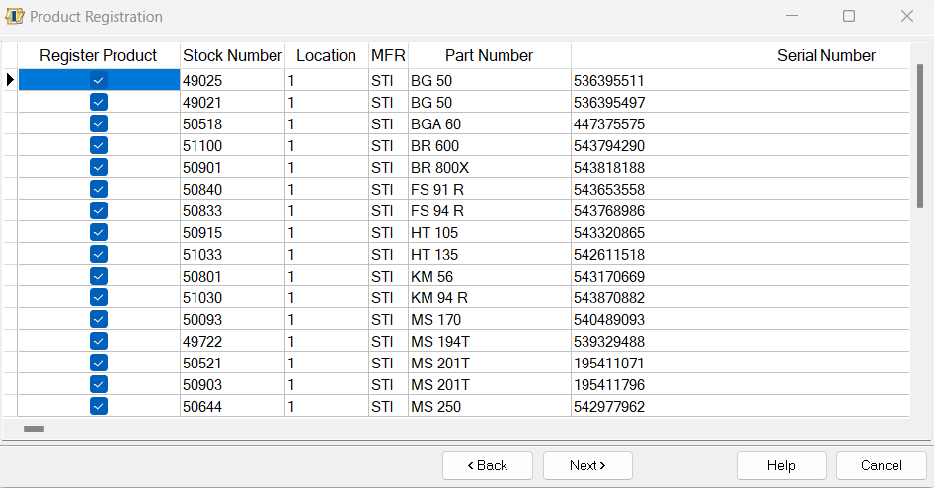
Only select units that will have the same parameters as all selected will be registered likewise

Slide 28
Knowledge Base Resources
How To – Create a Generic Interface
Electronic Interfaces (Setup completed by ideal Support)
How To – Batch and Individual Registrations
Unable to Register Stihl Product

