Slide 1
Inventory
Insights
February 2025
Jim Daum, Implementation Specialist

Slide 2
Agenda
1.
Mobile – Smart Devices
2.
Lost Sales / Special Order
3.
Cross Sale – Related Items –Suggestive Selling
4.
Additional % to Work Order Parts
5.
Manufacture Reps

Slide 3
Are you Walking Over $100 Bills?

Slide 4
Mobile

Slide 5
Lost Sales

Slide 6
Lost Sales
Keep Track and Record Them
Watch the Number of the same Product
Add to inventory based on demands
Let IDEAL Work For You

Slide 7
Lost Sales

Slide 8
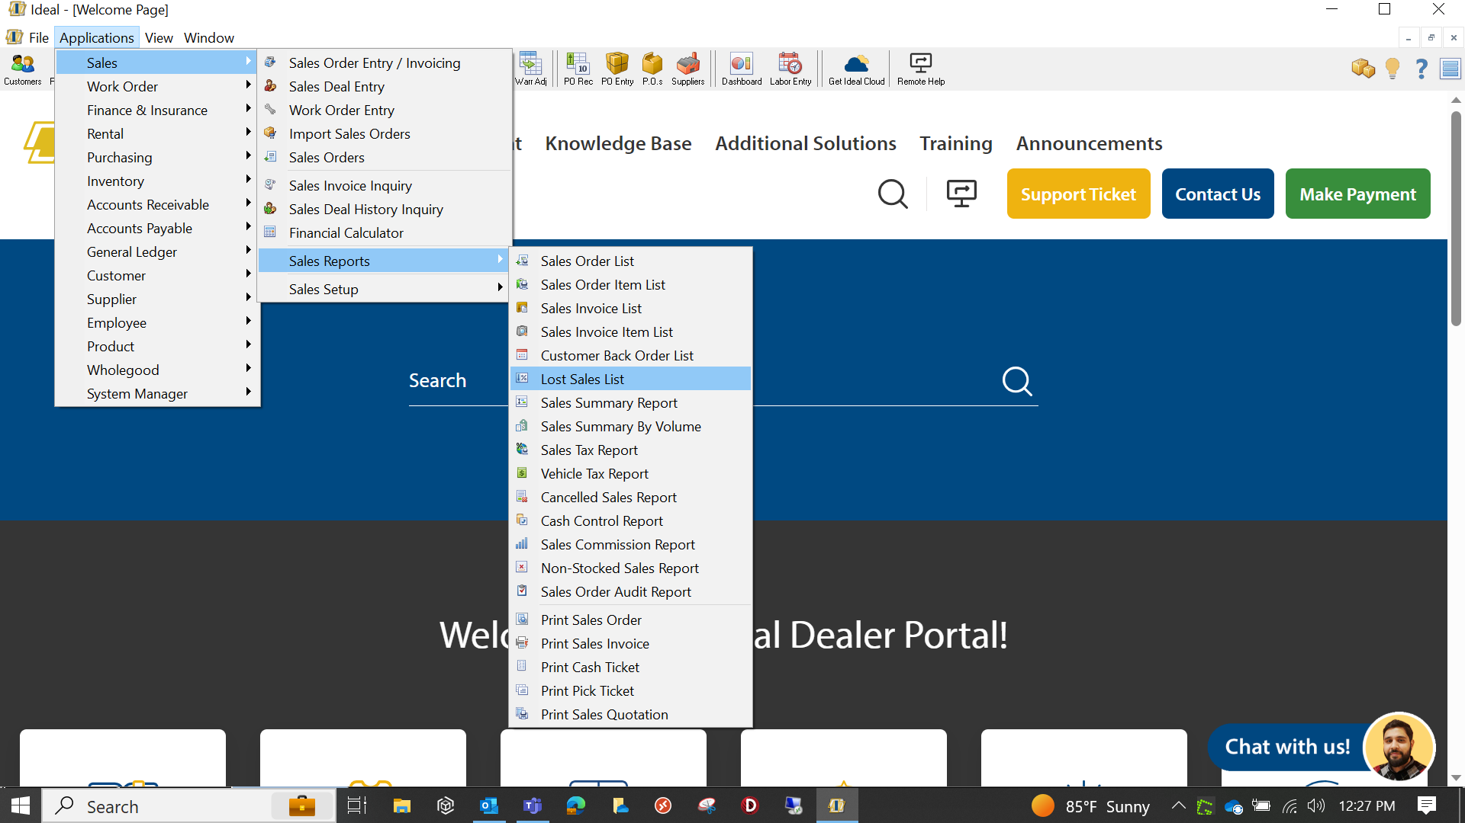
Lost Sales

Slide 9
Lost Sales

Slide 10
Special Orders

Slide 11
Special Orders

Slide 12
Special Orders
Monitor Them
Adjust Inventory Based on Demands
Let IDEAL work for you!

Slide 13
Special Orders

Slide 14
Special Order Filter

Slide 15
Cross Selling – Related Items
VS

Slide 16
Suggestive Selling
Approximately 30% of Customers Will Include an Additional Item
Just By Being Asked to Do So!
Notes:
AMAZON - Add Other Items or
You Might Also Like

Slide 17
Adding % To Work Order Parts

Slide 18
Adding % To Work Order Parts

Slide 19
Adding % To Work Order Parts

Slide 20
Manufacture Reps

Slide 21
Knowledge Base Resources
Ideal Mobile App
Lost Sales List
Work Order Preferences

Slide 23
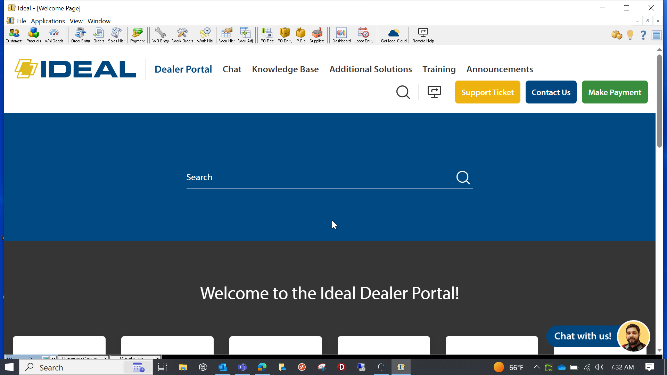
Additional Information

